Slide 1
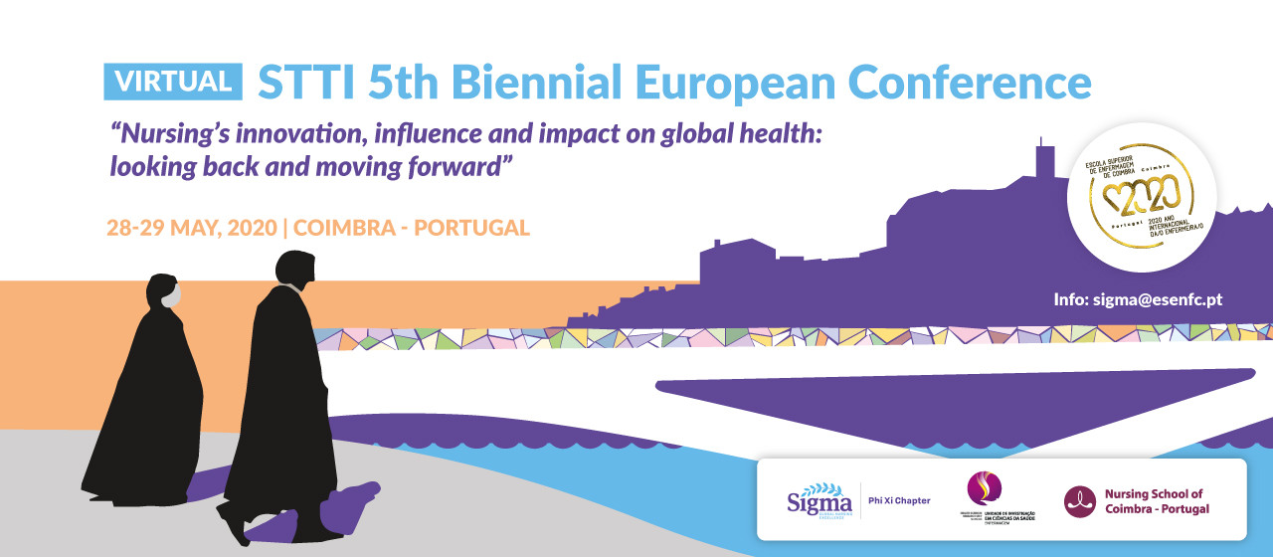
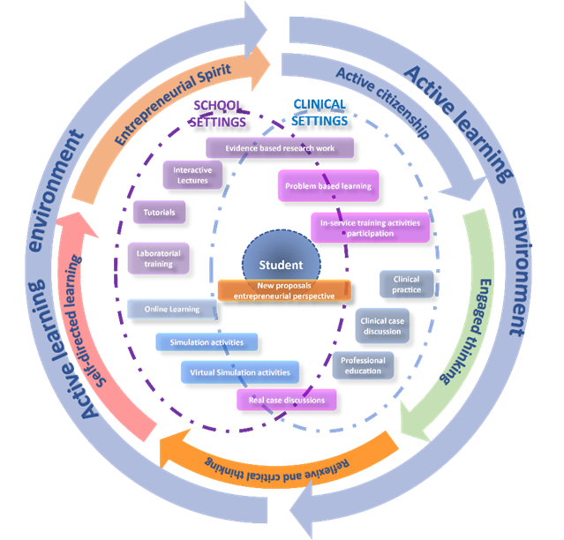
INOVSAFECARE MODEL: DESIGNING AN EDUCATIONAL MODEL FOR INNOVATIVE HEALTHCARE-ASSOCIATED INFECTIONS PREVENTION AND CONTROL IN NURSING EDUCATION
Maria do Rosário Pinto¹, Cassilda Sarroeira¹, Paulo Santos-Costa², Amelia Patrzała³, Raquel Guzmán Ordaz⁴, Ulla Korhonen⁵
¹ Escola Superior de Saúde de Santarém - Instituto Politécnico de Santarém, Portugal; ² Catholic University of Portugal, Porto, Portugal and Health Sciences Research Unit: Nursing, Nursing School of Coimbra, Portugal; ³ Institute of Health Sciences, Hipolit Cegielski State University of Applied Sciences in Gniezno, Poland; ⁴ University of Salamanca, Spain; ⁵ Savonia University of Applied Sciences, Finland
Keywords: Active learning environment; Healthcare-associated Infections; InovSafeCare Model; Nursing education
INTRODUCTION
Given the current challenges regarding Healthcare-Associated Infection (HCAIs) prevention and control (WHO, 2015), a European Consortium of Healthcare Higher Education Institutions (HEIs) proposed the development of a pedagogical model comprised of innovative teaching and learning practices for nursing students – the InovSafeCare Model. This model focuses on developing students’ competencies in HCAIs prevention and control, facilitating the learning of current best practice recommendations, encouraging critical reflection and the conceptualization of innovative solutions, contributing to the improvement of care quality and safety.
OBJECTIVES
The InovSafeCare model was conceptualized with the objective of helping nursing students in the development of their competences on HCAIs prevention and control, through the stimulation of critical thinking and decision making. Moreover, the model also aims to motivate nursing students’ creative and entrepreneurial spirit within this scope.
METHODOLOGY
A documental analysis of the current HCAIs-related content lectured across several European nursing HEIs was conducted, highlighting the main educational approaches/strategies used. To support the development of the model, empirical data will be collected through two questionnaires (for nursing students and teachers/tutors), qualitative and exploratory studies, and educational sessions with simulation scenarios, followed by group analysis and ventilations involving all relevant stakeholders.
RESULTS
So far, the InovSafeCare Model incorporates as pedagogical strategies active lectures, tutorials, clinical practice-based simulation scenarios, and assessment tests focused on HCAIs-related content. The InovSafeCare consortium is currently analysing the results of 900 questionnaires applied to nursing students from Portugal, Spain, Poland and Finland, as well as the transcription of 6 individual interviews and 13 focal groups conducted, in a total of 77 nursing teachers and tutors from five European HEIs.
CONCLUSIONS
The InovSafeCare Model advocates for a constructivist active learning environment, encouraging nursing students’ critical thinking on current HCAIs-related challenges and trends, enhancing their creativity, support self-directed learning and entrepreneurial skills.
References: World Health Organization (WHO). (2015). Global Action Plan on Antimicrobial Resistance. ISBN 978 92 4 150976 3. Retrieved from: https://apps.who.int/iris/bitstream/handle/10665/193736/9789241509763_eng.pdf?sequence=1.
Financing entities: Authors would like to thank the ERASMUS+ Programme for the InovSafeCare Project funding (2018-1-PT01-KA203-047453).

